Slide 1

How to Really use Udio Part 5

Slide 2
What is covered
What is Udio?
Getting Started
A Tour of the Environment
The Importance of Good Prompts
Creating Music
Working with Advanced Features
Remixing
Extending
Inpainting

Slide 3
Remixing

Slide 4
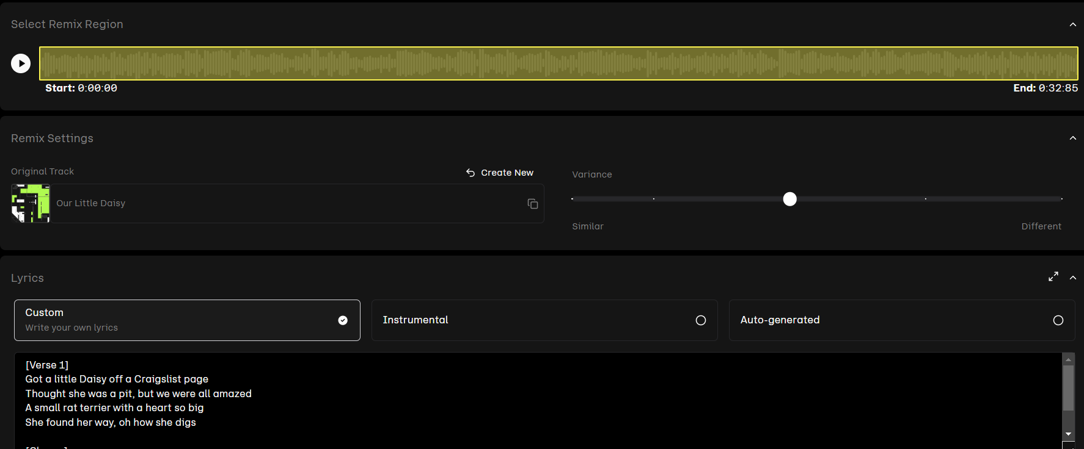

Slide 5




Notes:
https://www.youtube.com/channel/UC35ZpwldGw7ZJ5R-2sLijzw

Slide 6
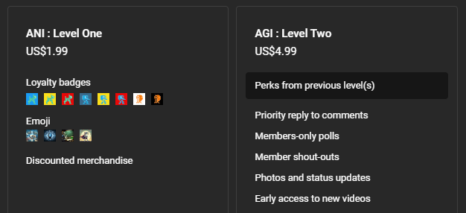

Membership has its privileges
Notes:
https://www.youtube.com/channel/UC35ZpwldGw7ZJ5R-2sLijzw/join

Slide 7

https://www.youtube.com/@AINewsFresh

Slide 8
extending

Slide 9
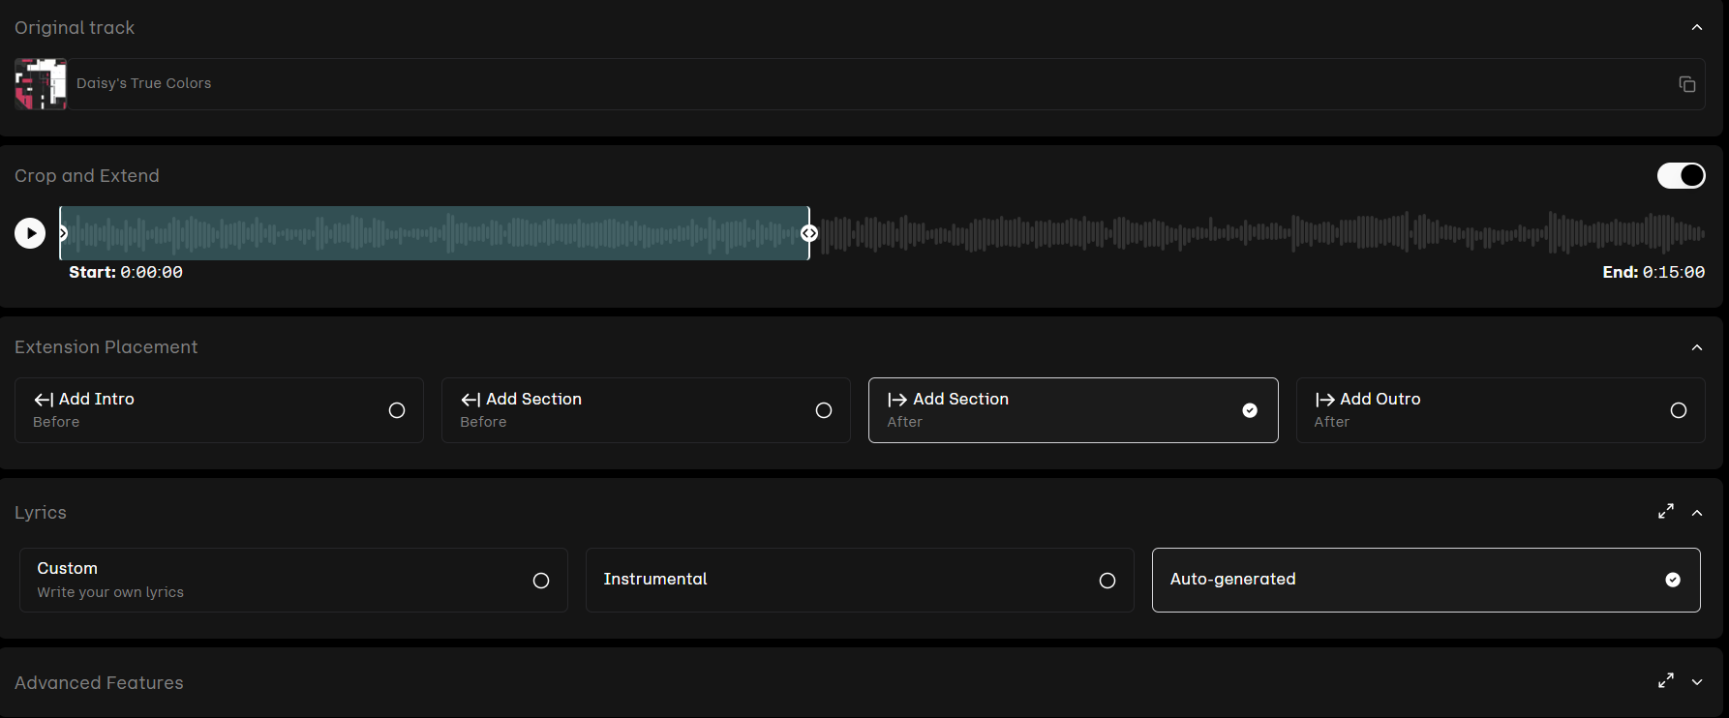

Slide 10
Inpainting

Slide 11
